Slide 1
Lecture 12: making sense of the Sociology of the Family
SC22o5: Sociology of the family

Slide 2
In this lecture…
How to prepare for the exam
Overview of main themes
How to make the most of Sociology of the Family

Slide 3
How to prepare for the exam

Slide 4
Exam format
The examination consists of two sections
You are to answer one question in Section A and one question in Section B
You must answer a total of two questions
All questions are equally weighted
The questions are essay questions… Aim to write a good essay!

Slide 5
How to write a good essay
Outline your essay before you start writing
An essay should have an overall argument
The argument of your essay should be clearly stated in the introduction
The body of the essay should weigh evidence for and against your argument
The conclusion should reiterate the thesis, in light of the arguments and evidence you have provided

Slide 6
Understanding the question
Your essay should focus clearly on the issues of the question you have been given
Understanding the question you have been given
What knowledge are you being required to demonstrate?
Identifying relationships between ideas
Are these ideas in support of each other, in opposition with each other, or somewhere in between?

Slide 7
Making an argument
The argument of your essay is your answer to the question and is a demonstration of your academic point of view
An argument requires
Coherence
Explanation
Evidence
Reason

Slide 8
Presenting your essay
Set aside for reading your essay
Ensure your essay uses appropriate academic language
Your punctuation and spelling are correct

Slide 9
How to score points with your essay
Make your essay clear and coherent
Demonstrate that you know the course content
Demonstrate that you understand the course content
Do not stress about authors
Do not give up… write something for each question
Do not try to b--- s---- your way through the exam!

Slide 10
how to prepare for the exam
Review all the main themes of the course
Focus on issues emphasized in lectures
Relate key examples to those themes
Identify main arguments in the readings
Answer the question: “Why did she make us read this?!!”
Relate those arguments to the main themes in the course

Slide 11
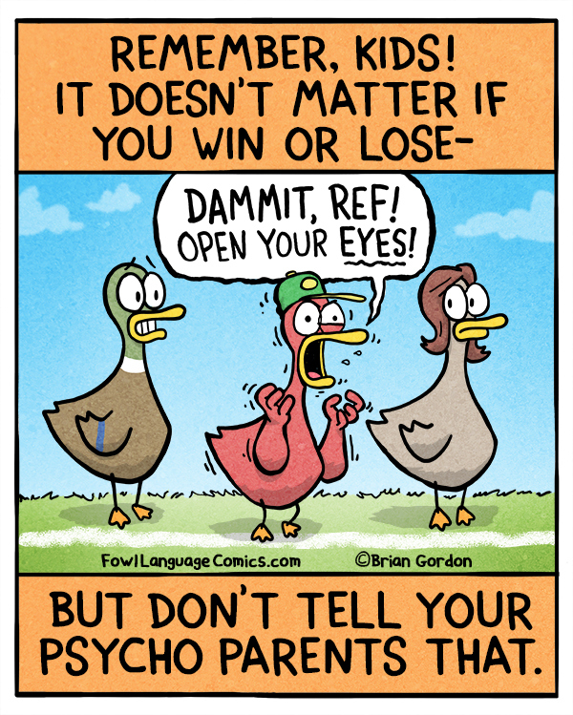
Questions?

Slide 12
Overview of main themes

Slide 13
Questions to answer…
What is the social construction of family?
What is the normal family ideology? How do transnational families challenge the normal family ideology?
What are the conceptual frameworks in the analysis of the family? How do they help us to understand the family?
How did romantic love come about?
What is exogamy and endogamy? Why are these rules important?
What is the marriage decline perspective and marriage resilience perspective?
Why is gender a performance more than an identity? How does doing gender relate to the division of labor? How does doing gender relate to fatherhood and motherhood?
How did biopower come about? What is the basis of biopower in public policies?

Slide 14
social construction of family
The meaning we attach to family is a matter of collective definition and human agreement
Our relationships to others become family relationships when we refer to ourselves and treat one another as a family
Notes:
Because we don’t live in isolation, and we are imbedded in institutions and organisations, and that affects what identity we take

Slide 15
Normal family ideology and social change
Our traditional family model of the married heterosexual couple with children based on a sexual division of labor where the husband as breadwinner provides economic support for his dependent wife and children, while the wife cares for both the husband and children
Increasing divorce rates and single mother households
Lifelong marriage as one of several alternatives
Women’s entry into the paid labor force and home-centered motherhood
Rising uncertainty in men’s economic futures and men as good providers
Notes:
Normal family ideology is a social construction.

Slide 16
Normal family ideology and Transnational families
Transnational families
Members of families retain their sense of collectivity and kinship in spite of being spread across multiple nations
What counts as care and what counts as acceptable family formations and practices are socially and culturally specific and negotiated within particular economic and political circumstances
It is common and acceptable for children to be raised by someone other than their biological parents
Women often migrate and assume the breadwinner’s role that has traditionally been ascribed to men
Notes:
Skepticism whether transnational families can adequately provide for the family.

Slide 17
Conceptual frameworks
Individual | Relationship | Family Group | Institution
Social Exchange | Symbolic Interaction | Family Development | Conflict
 |  |  | Family Development
 |  |  | Structural-Functional
Notes:
Framework occur on all levels of relationship, but easier to understand based on the levels depicted here.
SE- internalized beliefs and attitudes towards family
SI- interaction between family members; the idea of care and love
FD- organization of the family grp

Slide 18
romantic love
For most of human history, love had little to do with marriage
To acquire influential in-laws, effect business mergers, raise capital, improve social status, and expand family labor force
Presence and importance of romantic love
Focus on individual needs
Aided by popular culture and marital advice experts
Romantic love is more important as a basis for intimate relationships in individualist societies than in collectivist societies that emphasize group obligations
Notes:
Love regarded as fragile and weak
Relationships with family is more important than love
Love can be blamed on popular culture, idea of sole goal in life is to meet the one.

Slide 19
Exogamy
At any given point in time, each one of us is a member of many groups simultaneously
Exogamy
Rules that require an individual to form a long-term romantic relationship with someone outside certain social groups
In South Korea, for example, individuals are discouraged from marrying someone with the same surname
Incest
In almost all societies, exogamy rules define marrying or having sex with individuals in one’s own immediate family (siblings, parents, children)
Notes:
Frown upon to form teacher-student relationship

Slide 20
Endogamy
Endogamy
Rules that limit intimate choices to individuals within one’s social group, principally race, religion, and social class
Education and employment patterns
Individuals with similar backgrounds will come into contact and share common beliefs, values, and experiences
Rules of endogamy reflect our society’s traditional distaste for relationships that cross group boundaries

Slide 21
Divorce: the marriage dabate
When a society celebrates individual freedom, individuals’ intimate choices are likely to be driven by personal feelings and emotions
Rise in expectations of marriage
More file for divorce as their partners fail to provide love, companionship and emotional intimacy
In collectivist societies, individuals’ expectations can seem quite low
Low expectations may help to prevent marital breakups

Slide 22
Divorce: the marriage debate
Marital decline perspective
Individualistic perspective of marriage preoccupied with pursuit of personal happiness
Must create a culture that is supportive of marriage and commitment
Increase in pro-marriage programs; restriction on no-fault divorce
Marital resilience perspective
Divorce as second chance at happiness
Evolution of choice and opportunities for women lead to strengthening of intimate relationships
Promote social policies that provide greater support to adults and children (regardless of family type)

Slide 23
Doing gender
Children acquire knowledge about gender through socialization
But what they learn are the gender rules that allow them to be perceived as masculine or feminine
To become masculine or feminine, we must “do gender” appropriately and continuously through everyday social interactions
We do gender by behaving in ways that are considered appropriate for our gender
Gender is an accomplishment rather than a fixed attribute of each individual (West and Zimmerman 1987)
If we try not to do gender at all, others will do it for us
Notes:
A gender is always attributed to us

Slide 24
Doing gender in the home: The “second shift”
Because of persistent gender disparity in household and childcare responsibilities, Arlie Hochschild and Anne Machung (1989) point out that the average working wife routinely works two shifts – one at the office and one at home
The domestic work men tends to do is different from the work women do (Lee and Waite 2005)
When women earn more than men, couples may resort to a traditional division of labor in order to reinforce gender differences that could be undermined by the interchanging of traditional economic roles (Arrighi and Maume 2000)
Having children often means more work inside the house for women and more work outside the house for men (Cowan and Cowan 2000)
Notes:
Even when men do household chores, it is still different from the women. Men tend to do the chores that are infrequent, and optional ( e.g. car washing) as compared to meals (more time rigid)

Slide 25
Doing gender in the home: “Women’s work”, “men’s help”
Many men define domestic work as “help” (Hochschild and Machung 1989)
For example, some fathers tend to refer to their responsibility for childcare as “babysitting”
A key social element of “help” is that it obligates the individual receiving assistance to express gratitude
Defining unpaid household labor and childrearing as “women’s work” upholds male privilege in society
Are we experiencing as a “stalled revolution”?
Notes:
Mothers do not use this term of babysitting a child.
Men “helping”

Slide 26
Doing Gender in the workplace: gender discrimination
Imagine you are a boss and you have just been told that your best employee, Chris, is engaged to be married…
Man
Woman
His upcoming marriage as a “stabilizing” influence
Job security extremely important, making him a more dependable worker
Need a raise because of impending fatherhood
Motivated to work harder and longer to support his family
Her upcoming marriage as potential impediment to career mobility
Will she move if her husband finds a good job somewhere else?
How long will it be before she becomes pregnant and seeks maternity leave or quits?
Marriage makes her seem less dependable, less stable, and less committed to the job

Slide 27
Doing gender: Motherhood
Maternity
The state of being pregnant and giving birth
The assumption that maternity gives women not only the ability but also the desire to nurture
The primacy of the biological mother-child bond
Despite their increased participation in the paid labor force, mothers in postindustrial societies are more invested and involved in the day-to-to lives of their children than are fathers
Women in our culture are still socialized to value the rewards of motherhood and to believe that having children is a primary source of self-identity

Slide 28
Doing gender: Working mothers
Cultural ambivalence regarding how mothers ought to behave
Images of stay-at-home mother versus working mother
Both images are considered socially acceptable but both are also indicted for their failings
These images lead many women to feel less than adequate
In contrast to fathers
Mothers have to justify why they are working outside the home
Mothers’ employment is still perceived as optional or potentially damaging to family life
Notes:
Both images are critised

Slide 29
Doing gender: male breadwinning role
Men’s choice is no choice at all
Men are still expected to attach primary importance to their careers
In addition, the workplace still discourages men from completely abandoning the breadwinner role
The breadwinner ideal is still associated with maturity, respectability, and masculinity and remains the unifying element in the lives of most fathers today

Slide 30
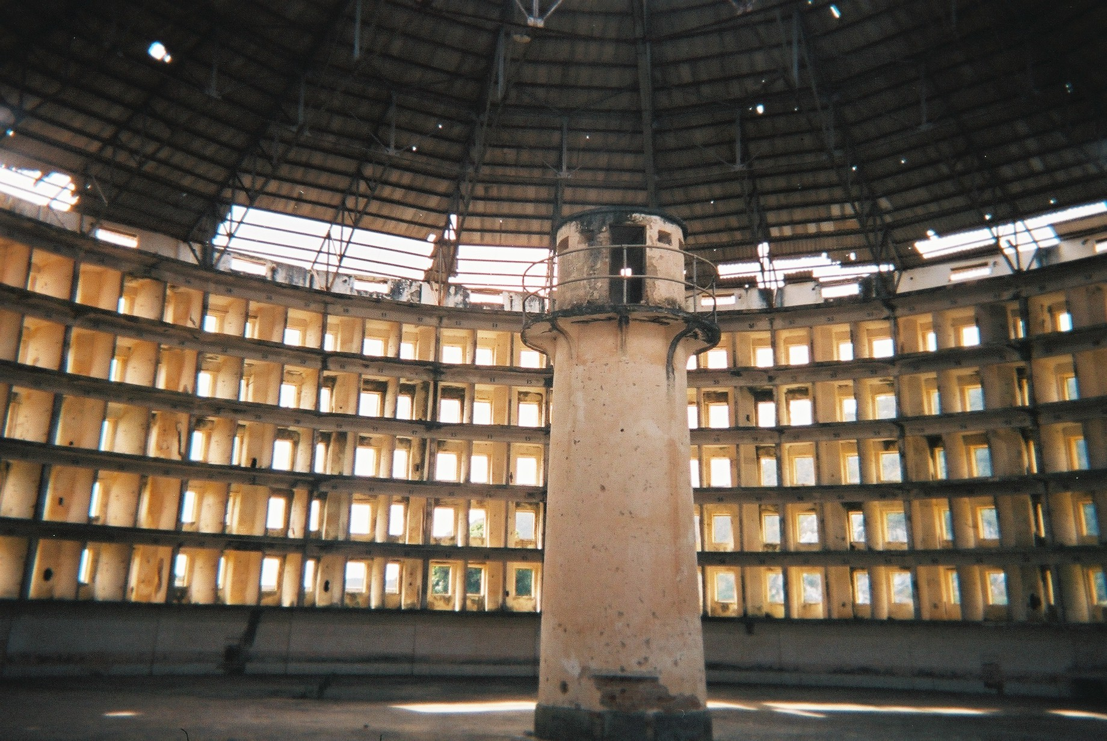
Biopower and public policies
The Panopticon Design
Notes:
We discussed Michel Foucault’s ideas about biopower and how it relates to public policies
In particular, how the latent or unintended function of the government is to regulate families through the production of docile bodies
Foucault shows how the architectural design and organization of the prison provides a perfect surveillance machine
With the panopticon design
The prisoners are constantly in view of a central guard tower but cannot ever be sure when they, specifically, are under surveillance
A prisoner, knowing that he may be watched at any moment, eventually becomes docile
He becomes his own warden and regulates his own behavior
Foucault labels these structures and practices “disciplinary technologies”
Under biopower, disciplinary technologies aim to produce a human being who would behave as a docile, yet productive, body
In Singapore, ‘‘the family,’’ through various public policies, has come to take on very specific definitions
Reflecting the normal family ideology, the Singaporean couple formed through heterosexual marriage – where both man and woman are employed in the formal labor market, and where the couple has older and aging parents and young children to support – has become the normalized form of imagining family
This type of familial membership is explicit criterion for accessing housing and support for caregiving
Policies creates norms
And internalises these norms and thus less deviance from it
Stigma associated with other forms are not seen as norms.

Slide 31
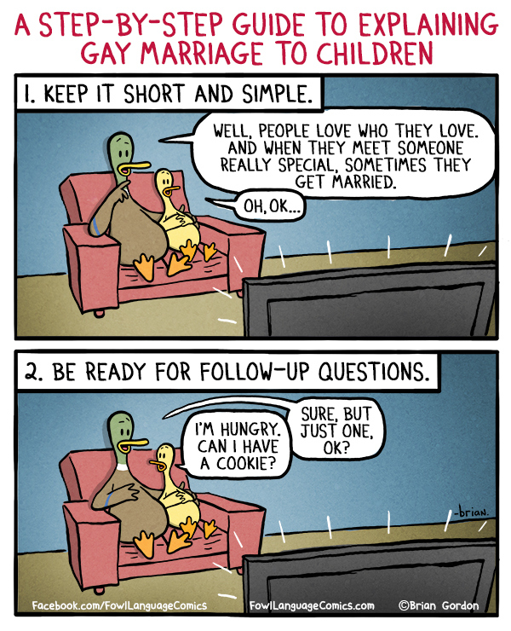
Questions?

Slide 32
Implications of sociology of the family
Family diversity has always characterized family life and will continue to do so (Thus no such thing was “the family”)
The experiences that individuals have with their own families will always be filtered by their gender, race, religion, social class, and other social characteristics
Each change takes place within a particular context and, in addition, each aspect of family life shapes other aspects
Notes:
Family no longer becomes a private sphere but also tied with other historical and social focus
Families will continue to exist in the future

Slide 33
Insights from sociology of the family
Be wary and skeptical of commentators, critics, politicians, and fellow citizens bearing simple answers to complex family questions
Understand families for what they truly are
Families will be the same as they have always been
Families will never be the same again

Slide 34
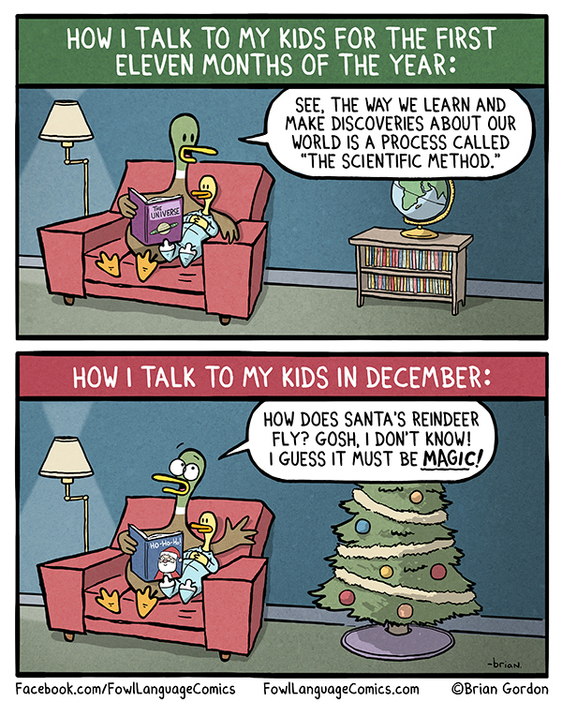
Questions?

